Slide 1
Chapter 7
Meet JSX...Again!

Slide 2
Objectives
What Happens with JSX?
JSX Quirks to Remember
Evaluating Expressions
Returning Multiple Elements
You Can’t Specify CSS Inline
Comments
Capitalization, HTML Elements, and Components
Your JSX Can Be Anywher

Slide 3

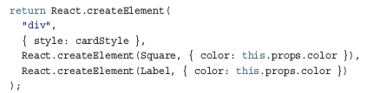
What Happens with JSX?
How does it end up as the HTML that you see in the browser?
This means that the JSX we write is for human (and well-trained cat) eyes only. When this JSX reaches our browser, it ends up getting turned into pure JavaScript:

Slide 4
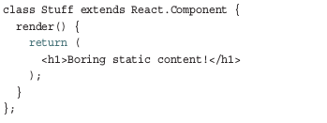
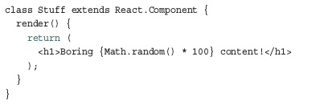
JSX Quirks to Remember
Evaluating Expressions:
JSX is treated like JavaScript. As you’ve seen a few times already, this means that you aren’t limited to dealing with static content like the following:
The values you return can be dynamically generated. All you have to do is wrap your expression in curly braces:

Slide 5
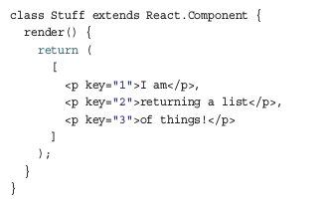
JSX Quirks to Remember
Returning Multiple Elements:
You can actually return multiple elements. And you can do that in two ways.

Slide 6

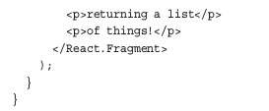
JSX Quirks to Remember
Using fragments return multiple elements.
Note a few cool things here:
1. This component doesn’t actually generate a DOM element. It is just something you specify in JSX that has no tangible existence when transpiled into the HTML your browser sees.
2. You aren’t treating what you are returning as items in an array, so you don’t need commas or anything separating each item.
3. There’s no need to specify a unique key attribute and value; this is all taken care of under the covers for you.

Slide 7
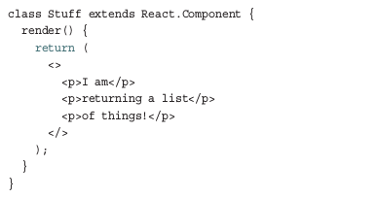
JSX Quirks to Remember
Use a more condensed syntax instead of fully specifying React.Fragment... like an animal. You can use just empty <> and </> tags:

Slide 8
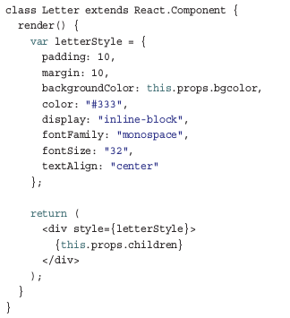
JSX Quirks to Remember
You Can’t Specify CSS Inline:
In JSX, the style attribute can’t contain CSS inside it. Instead, it needs to refer to an object that contains styling information
Notice: that we have an object called letterStyle that that contains all the CSS properties and their values.

Slide 9
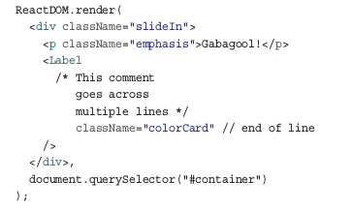
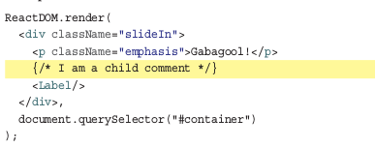
JSX Quirks to Remember
Comments:

Slide 10
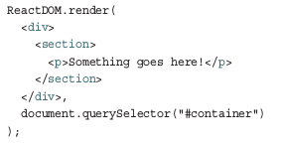
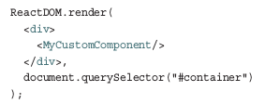
Capitalization, HTML Elements, and Components
To represent HTML elements, ensure that the HTML tag is lowercase:
When you want to represent components, the component name must be capitalized:

Slide 11
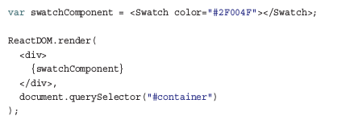
Your JSX Can Be Anywhere
In many situations, your JSX won’t be neatly arranged inside a render or return function as in the examples you’ve seen so far. Take a look at the following example:

Slide 12
Conclusion
The most important point to remember is that JSX is not HTML.
It looks like HTML and behaves like it in many common scenarios, but it is ultimately designed to be translated into JavaScript.
This means you can do things that you could never imagine doing using just plain HTML.

